Slide 1
Final Accounts
Trading account, Profit and Loss account and Balance sheet

Slide 2
Trading Account

Slide 3
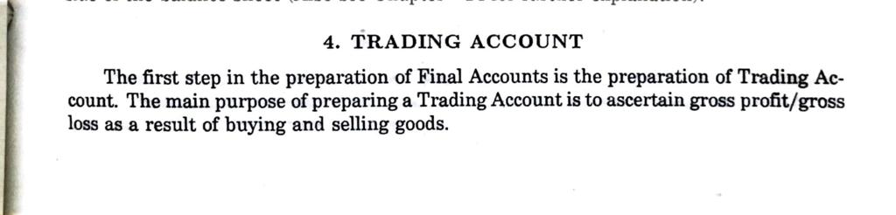

Slide 4
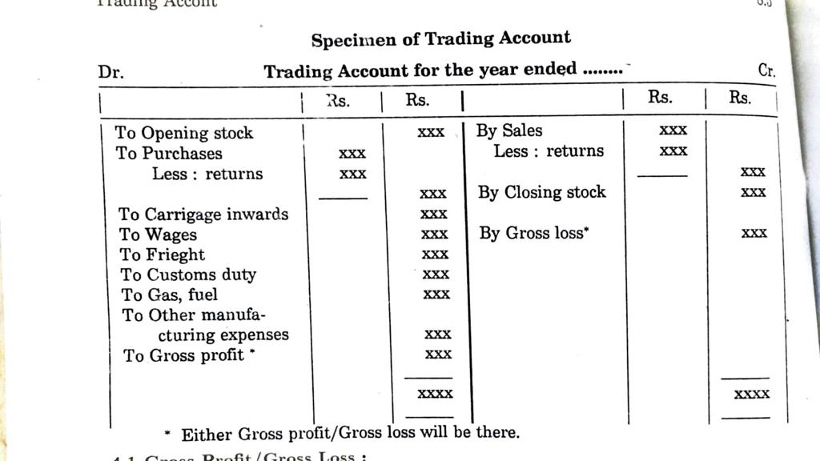
Trading Account Format

Slide 5
Profit and Loss Account

Slide 6
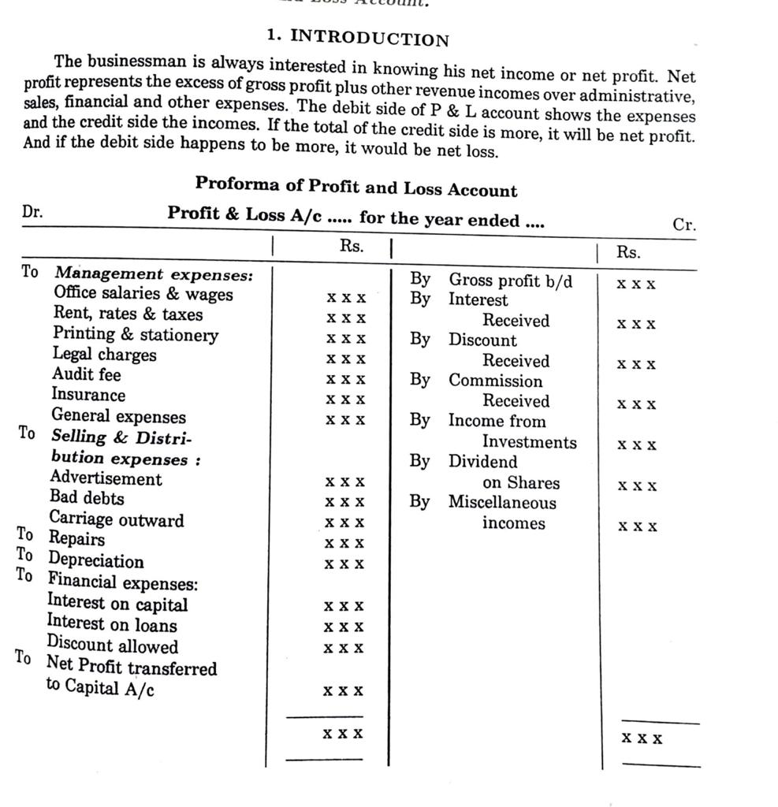

Slide 7
Profit and Loss Account Format

Slide 8
Balance Sheet

Slide 9
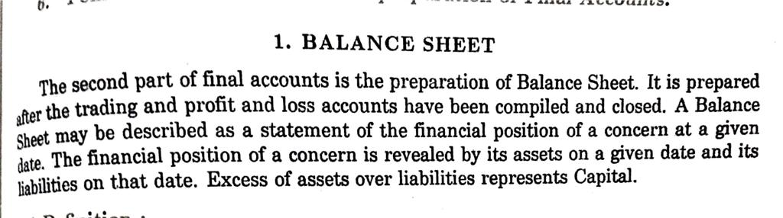

Slide 10
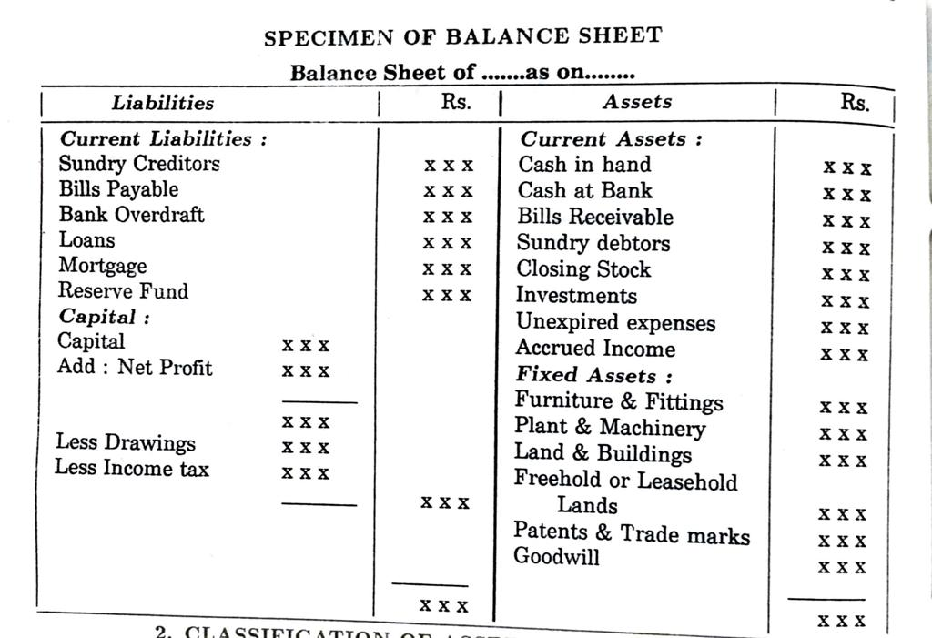
Balance Sheet Format

